Slide 1
Custom Pages
Extending MinistryPlatform to Store Meaningful Information
Matt Patterson
Rocky Mountain Calvary
Colorado Springs, CO
Notes:
Personal Info
Family/hobbies
Worked for DEC, Compaq and HP for 7 years.
Rocky Mountain Calvary, Colorado Springs, CO
On staff since 2004 as pastor/IT.
Implemented MinistryPlatform in October 2014
Role as pastor/IT has been really helpful to work to bridge ministry with IT.
Learn about audience
How many people are using custom pages?
How many would like to use custom pages?

Slide 2
Session Focus
What is a custom page?
Why use custom pages?
What are the benefits of using custom pages?
How to create custom page
Best practices to follow when creating custom pages

Slide 3
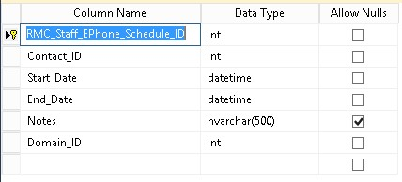
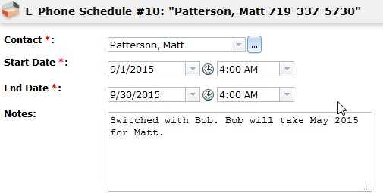
What is a custom page?
A page you create in MinistryPlatform containing information meaningful to your ministry.
A page displaying information from a SQL Server table you have created.
Notes:
I don’t want to assume the everyone knows that a custom page is….
Practically – It is information that is important to your ministry. It can be anything that is meaningful to you.
Technically - A custom page is a page in MP that contains data from a table in SQL Server. (insert table and page image on a slide).

Slide 4
Why Use Custom Pages?
Does MP capture all the information relevant to your church?
What is unique about your church/ministry that is important to capture in a database?
What information is acted upon on a daily basis that is stored in an area other than MP that many people need?
What can you store that will help other staff members do their ministry more efficiently?
Notes:
If not, what is something you want to add to MP that is unique/meaningful to your ministry?
To help answer these questions, consider what are people using on a DAILY basis – OR – what information is CRITICAL to the function of your ministry?
What information are other staff people storing in another location? Remember before MP or whatever CMS you were using? Where were names and phone numbers stored? How were you sharing information?
Consult MP’s page on what to consider before creating a page to help answer these questions.

Slide 5
What are the Benefits of Custom Pages?
Data is stored in one location and leverages existing information.
If MP is the cornerstone of your Church Management System/Software, then it keeps staff focused on using one tool.
It presents/shares relevant data to staff to help them do ministry more effectively.
Once data is stored, it can be acted upon (searches and processes) and presented in meaningful ways(views and reports).
Notes:
Leveraging info – For example, I can create a relationship to the Contacts tables to get all by data on someone involved in my ministry rather than keeping my own copy of the data. This data is up to date, because everyone is using it and maintaining it.
Some people may use MP as a glorified address book. That is the only reason they need it. Then they ask how to do something simple like send a message and it drives you nuts you have to go over it again and again. However, if you make this the “killer app” for them, they are driven to it and learn how to use it.
Why do we do what we do? We want further the cause of Christ! You are helping people become more effective in how they manage their data!!!
Once you add data to MP, that data is now made available to MP to be acted upon in many ways.
Let’s get started!!!

Slide 6
Test System (Sandbox)
Creates a copy of your MP db and the MP web app.
Best practices
Bookmark your production and test sites CLEARLY
Use a different color scheme for each site
Use different passwords for each site and force yourself to log into the test site
Notes:
What is the FIRST thing do to? Do you want to make friends at ThinkMinistry? ☺
Create a TEST SYSTEM!!!
There was another session today on setting up a Sandbox. TM has instructions on how to set it up. You can do it even if you know very little about IIS and SQL Server.
Best practices – Purpose of these practices is to help you keep from getting your test site confused with the production site.
When creating a bookmark for your site, don’t place it next to your production bookmark.
Change the color scheme of MP.
Create a different password.

Slide 7
Creating Custom Pages - Overview
Create the SQL Server table
Create Pages and Views
Configure security roles
Notes:
Creating pages can be broken down into a three step process.

Slide 8
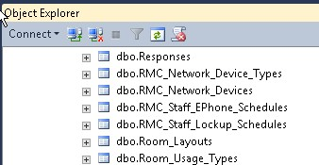
Table Creation
Naming conventions
Primary key
Table relationships
Document table design
Domain_ID field
Notes:
Everything I discuss on this slide assumes you have the knowledge to create a table in SQL Server.
New table naming conventions. Tables names should:
Begin with a prefix to differentiate those tables from tables created by ThinkMinistry.
Be plural (e.g., Contacts to store each contact, Events to store each event).
Use underscores rather than spaces between words. Do not use any special characters (e.g., “/” or “-“).
New tables should have a field that uniquely identifies each record. This field will be the primary key (PK) for that table. The PK should be named the singular version of the table name followed by “_ID”. For example, the Contacts table will have a PK named Contact_ID.
New tables will most likely be related to existing tables to leverage existing information. In such cases, fields will need to be created to relate to existing tables. Such fields will have a foreign key (FK) that relates to the primary key of associated tables.
Plan and document the fields, data types and properties for each field.
Each table will need to have a field with the following properties in order to work properly with existing tables created by ThinkMinistry:
Field Name: Domain_ID
Data Type: int
Allow Nulls: No

Slide 9
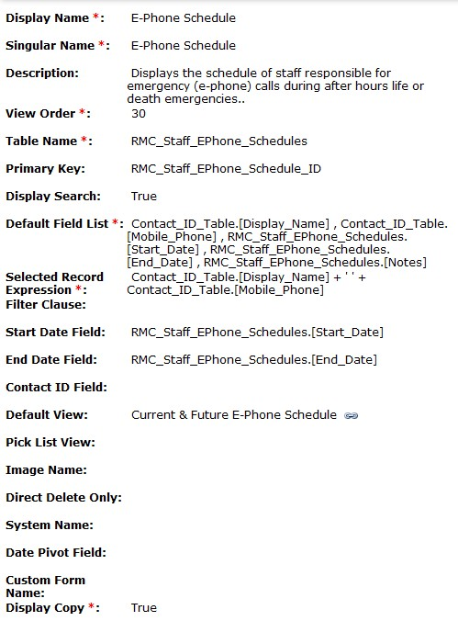
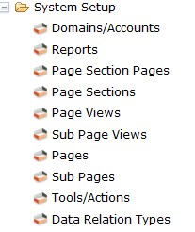
Page Creation
Create new pages in the System Setup folder in MP (System Setup -> Pages)
Configure page by editing page fields
Assign page to a page section
Notes:
Once your table is created, we need to create the page that will link to the table. This is how we get MP to recognize the data in SQL Server.
Log into MP and click on System Setup -> Pages and click New.
Complete the fields on the new page as appropriate to your table. A few fields are noted here:
Start Date Field and End Date Field – The Start Date field with the datetime data type is necessary when a user desires the Calendar view of a page. The calendar view uses the start and end date in a record in order to plot data correctly on the calendar.
Default View – When left blank, the default view will be all records in the table. Otherwise a user created view can be used to display the page.
Display Copy – Allows the Copy verb to appear so users to copy an existing record.
Assign the page to a page section.
Create a new page section if necessary (page sections are the folders that contain pages in the left window pane).
Open System Setup -> Page Sections
Assign a name and a view order.
Add the page to the appropriate section.
Open System Setup -> Page Sections and open the desired page section.
On the Pages subpage, click New to add the page to the desired section.

Slide 10
Default Field List Makes Fields Available as Merge Fields in Email Templates
Notes:
Default Field List– The view that is shown by default when displaying selected data in the table. This is the data when shown in the Grid view. Fields in this list will be available as merge fields in email templates. For example, if you would like to create a process that sends an email and it includes data from the page/table, included that info in this list.

Slide 11
Selected Record Expression
Notes:
Selected Record Expression – This is the “friendly name” of the record. It’s what will appear when that record is used as a foreign key (drop down list) on another page. In other words, it’s the way a single record expresses itself on a page.

Slide 12
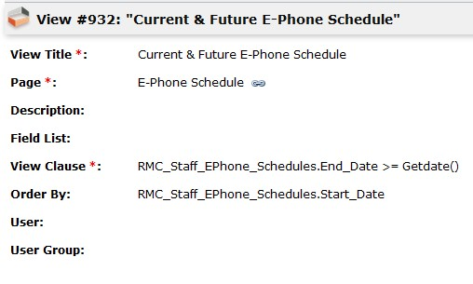
View Creation
Create new views in the System Setup folder in MP (System Setup -> Page Views)
Configure view by editing view fields
Assign view to the page
Notes:
Views can be created to display page data with the desired sort order and columns most users will appreciate.
Go to System Setup -> Page Views. Click New.
Configure view by editing view fields:
Page - The page in which the view is available.
View Clause – The condition used to filter the data.
Order By – The field used to sort the data.
Add the view to the page.
System Setup -> Pages. Open the page that will contain the view.
Click on the Page Views subpage and add the view.
If the view will be the default view for the page, then edit the page and change the Default View value to the name of the view.

Slide 13
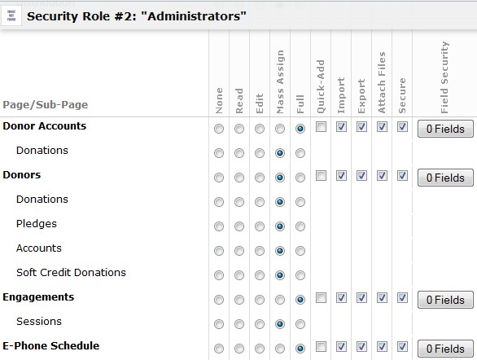
Security Configuration
Give permissions to view and edit pages*
Configure security in the Administrator folder (Administrator -> Security Roles)
Best practice
*Note: If you do not give a user permission, the page will not be visible.
Notes:
Users must be given security rights to the page (including Administrators) in order for the page to be viewed.
Give permissions to users to view and edit pages.
Open Administration -> Security Roles.
Edit each security role that needs to access the new page.
Best practice
Give full rights to the Administrators role.
Log out and log back in to verify the page can be seen properly.
Impersonate users needing to access the new page if necessary.

Slide 14
Testing
Test to ensure all work has been completed properly
Data should be added, edited and deleted on every new page.
Add a variety of records over time.
Test all views (grid, calendar, etc.)
Test all the verbs for the page
Notes:
Once the tables and pages have been created, testing should be done to ensure everything has been created properly.
Data should be entered into each table to make sure new records can be added, edited and deleted. Data should be entered into every field of the new page.
It is important to add a variety of items to the page over time. Doing so will help to ensure all the proper fields have been created to capture the data intended for the page. If time is not taken, you may discover that new fields need to be added after the page is in production.
Make sure data displays properly in every view that is applicable to the page (i.e., Grid, Calendar, Gantt and Images views).
Test any views created for the page.
Check the pages that are related to the newly created tables. In most cases, when a new table is created there is a relationship to another table containing relevant data. For example, a table may have a relationship to the Contacts or dp_Users table. In such cases make sure a record in the related table can be added and updated. Repeat this testing process for ALL related tables.
Test all the verbs for the newly created page to ensure they work correctly.
Keep in mind an administrator needs to give the tester full access to all verbs for testing purposes.

Slide 15
Transfer to Production
ALWAYS PERFORM A BACKUP BEFORE MAKING ANY CHANGES TO THE PRODUCTION DATABASE.
Create a script of the table(s) to transfer to production
Manually insert data on the test server pages into the new product pages
Notes:
***Always perform a backup before making any changes to the production database.***
When moving tables into production, there are three primary concerns: creating the tables, creating the proper relationships between tables, and inserting the data in the proper order if the new tables have a parent/child relationship.
Create a script of the table(s) to transfer to production.
In the source database, right-click the table to script and select Script table as… -> CREATE to… Then select the where to send the T-SQL script.
Go through the wizard to select the tables to script.
Run the create table statements on the production server (see Table Creation Notes below).
Follow the steps to create sections, pages, views, etc. as was done on the test server.
Copy the information for each object in the System Setup folder on the test server and paste it to the objects on the production server.
Manually insert data on the test server pages into the new product pages (If a significant amount of data has been added during testing, the tables may need to be imported into the production SQL Server database).
Grant only access to an administrator and test all new additions to the production server. Once testing is complete, permissions can be given to users.

Slide 16
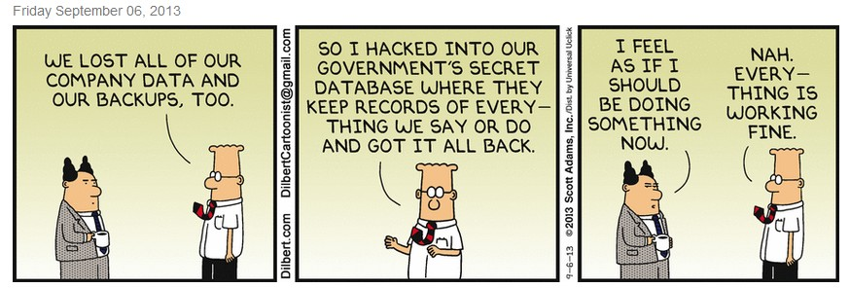
Emergency Restore

Slide 17
Examples
Lockup and E-Phone Schedules
Network Devices and Device Types
Counseling
Notes:
Also talk about:
Changing the color scheme on the test MP system.

Slide 18
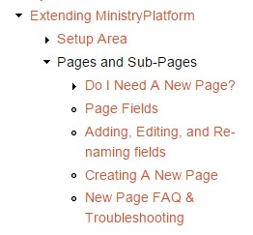
For More Information
Read the ThinkMinistry KB pages “Extending MinistryPlatform – Pages and Subpages”
http://www.thinkministry.com/kb/ministryplatform/pages-and-sub-pages
Video on how to create a page

Slide 19
For More Information
Downloads: rmcalvary.org/mpug
Session handout
PowerPoint presentation
How to transfer using data export/import.
Table/Page planning and documentation guide
mattp@rmcalvary.org

Slide 20
Questions

