Slide 1
Principles of report writing
Creating Paginated Reports with Report Builder 3.0

Slide 2

Hello!
I am Matt Patterson
IT Director/Pastoral Care
Rocky Mountain Calvary
Colorado Springs, CO
mattp@rmcalvary.org

Slide 3
Session Purpose
The basic elements of a report
Applications used to create/manage reports
Report Deployment to MP
Demo: Create a simple report and make it available within MP
Notes:
Must you know how to write T-SQL code to get something out of this session? No. But you will need to find someone that knows T-SQL to help you create a report.
There are many elements that go into creating a report (knowledge of SQL Server, T-SQL, MP system setup).
I’m going to keep two perspectives in mind. One is presenting from a conceptual perspective, the other is from actually demonstrating how to create a report from scratch. Don’t get discouraged if you don’t know everything I am talking about. Just take the concepts away if nothing else.

Slide 4
Reporting Elements
Understanding the Basic Concepts of a Report

Slide 5
What is a report?
A report is a one or more datasets formatted to share as a printed document or a PDF file
Notes:
A report is needed when it needs to be printed in a nice format when a view won’t do. Or, if calculations or some type of analysis that needs to be done. Examples: Overdue marital reports, overdue volunteer applications.

Slide 6
Three Necessary Elements to Create a Report
Where?
Machine name
Database Name
Authentication
Data Source
What?
What tables?
What rows?
What columns?
Dataset
How?
Presentation
Layout
Text/graphs
Report Objects/
Layout
Notes:
When creating a report, there are three elements what must exist in every report. These elements define a report.
Where – Where is the data coming from?
What – What data do you want to show in your report. The dataset is usually the main reason why the report is being created.
How – How do you want the data presented. This is another main reason for the report. Not only do you want a specific set of data, but you want it presented a specific way. Most importantly, you want the data in a printable format.

Slide 7
Data Source - Where’s the Data?
Machine Name: MP Server Name
Database: MP Database Name
Authentication: SQL Server login
Notes:
When creating a data source, you must specify the computer name where the your MP SQL Server database resides, you must specify the database name, and then you must use an account that has access to the data you want to use for your dataset..

Slide 8
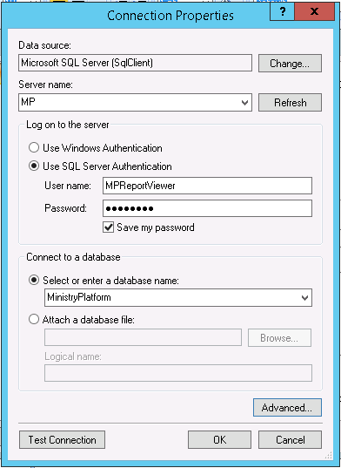
Data Source Connection Properties

Slide 9
Dataset – What Data Do You Want?
The set of data to be displayed in your report.
MUST be created as a stored procedure (SP) with three parameters
  Domain GUID
  User GUID
  Page ID
Assign prefixes to SP names
  RMC_report_Staff_Phone_Schedule
Notes:
This is typically the main reason the report is being created. If you’re familiar with views [List some dataset ideas]: 1. A list of events to go over with staff each month, 2. currently open/processing volunteer applications, 3. Overdue volunteer applications, 4. How many people have birthdays next month.
Datasets must be created using a stored procedure (SP). Behind the scenes, MP is passing information to the report (domain, user and what page the report is on).

Slide 10
What the Heck is T-SQL or a Stored Procedure?
T-SQL (Transact-Structured Query Language)
SELECT = Read, INSERT = Add, UPDATE = Change, DELETE = Remove
A Stored Procedure = Complied and saved T-SQL code.
Notes:
This is the most technical part of our talk, so if you can get through this part, you’ll be in good shape!
T-SQL is Microsoft’s implementation of SQL (Structured Query Language).
This is the language that is used to interact with the data that is in SQL Server.

Slide 11
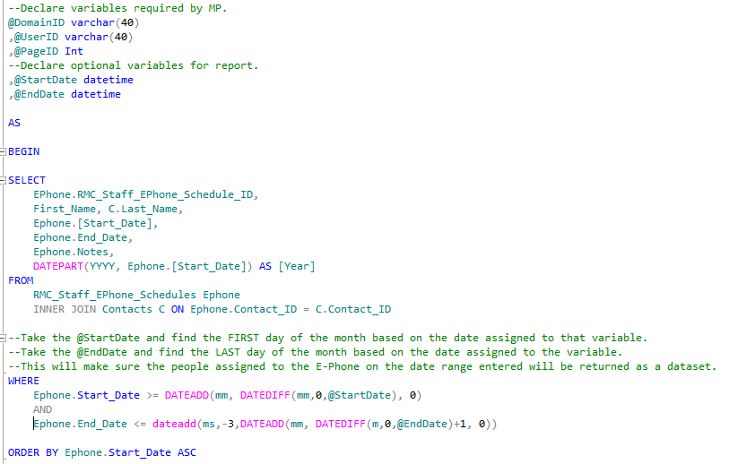
Place your screenshot here
Stored Procedure Example
Notes:
Point out the similarities between this UI and the office UI.

Slide 13
Report Authoring and Management
SQL Server Reporting Services
&
Report Builder 3.0

Slide 14
Report authoring tools
Visual Studio
&
Report Builder
Notes:
Just as you use an application for word processing (e.g., MS Word), you also use one of two applications for report authoring – MS Visual Studio or MS Report Builder. The versions of the product you use are important. You need to use the version of VS that comes with your version of SQL Server. So, install the version that comes with your version of SQL Server. Report Builder is a separate download that does not come with SQL Server. Report Builder has an Office like interface where as VS has an interface that is used by developers. So, use whichever interface is more familiar to you. I have only used Report Builder.

Slide 15
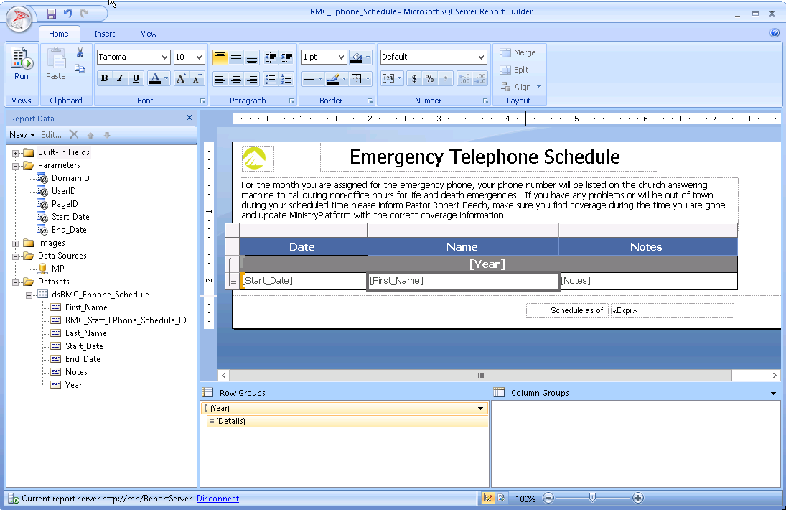
Place your screenshot here
Report Builder 3.0
Notice the “Office” like interface
Notes:
Point out the similarities between this UI and the office UI.

Slide 16
Sql Server Reporting Services (SSRS)
Web application used to store and manage report files
Notes:
SSRS is to manage and store your reporting files. SSRS is installed using your SQL Server installation media. The SSRS install creates a database on SQL Server for your reports and a web service/application to manage the report files. SSRS is to your web authoring app what Windows Explorer is to MS Word. Within SSRS you can create folders, rename reports, and many other things.

Slide 17
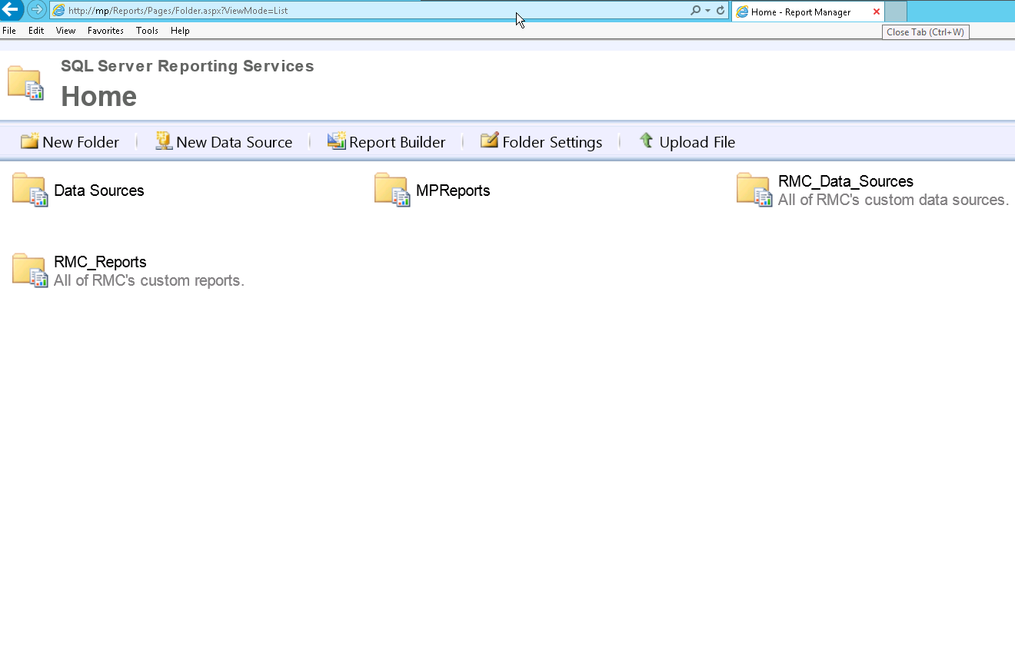
Place your screenshot here
SQL Server Reporting Services (SSRS)
The version of SSRS installed with SQL Server 2012
Default path: http://[Computer_Name]/reports
Notes:
When you first use SSRS, you will only have two folders: “Data Sources” and “MPReports”. These folders are created by ThinkMinistry. You should create your own folders and your own data sources to keep them separate from the ThinkMinistry objects.

Slide 18
Deploying Your Report
Using the System Setup area in MP

Slide 19
Deploying Reports in MP
Create
Report
Object
In MP
Assign
Your
Report
To a
MP Page
Assign
User
Permissoins
In MP
Reports are configured in the System Setup and Administration sections in MP
Notes:
Report objects and report configuration is done in MP’s System Setup area.

Slide 20
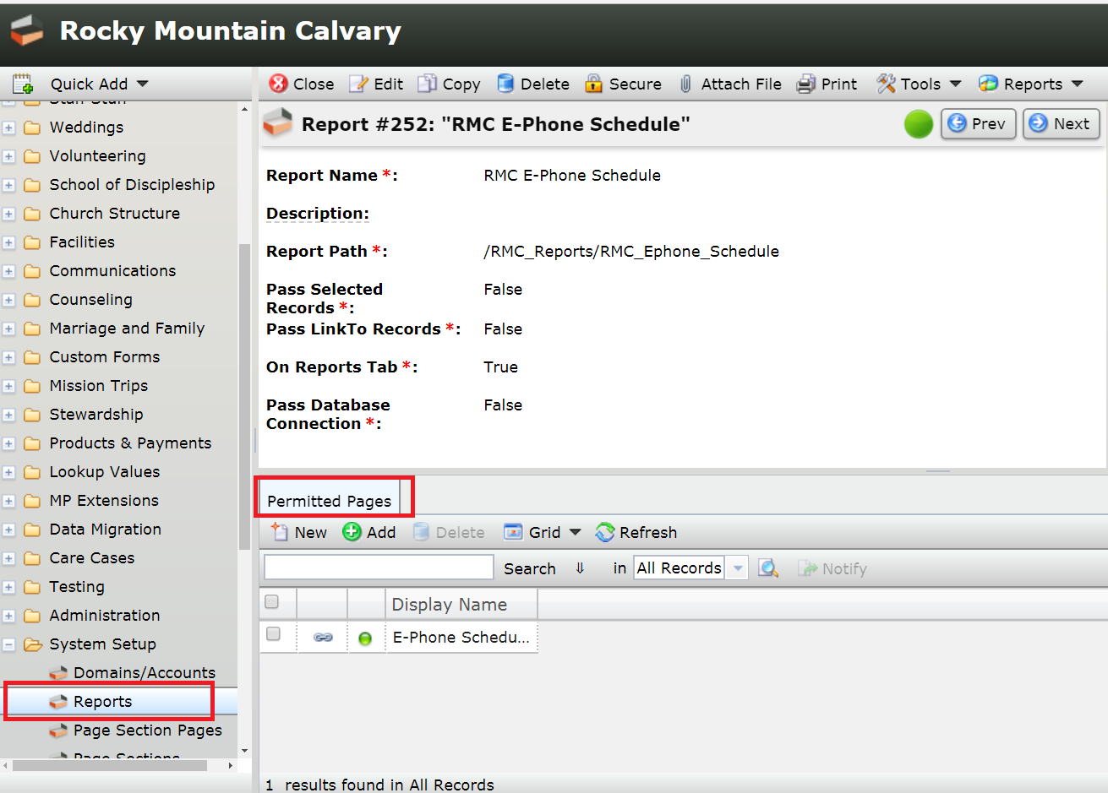
Place your screenshot here
Create Report Object and Assign to Page
Notes:
First go to the System Setup -> Reports page.

Slide 21
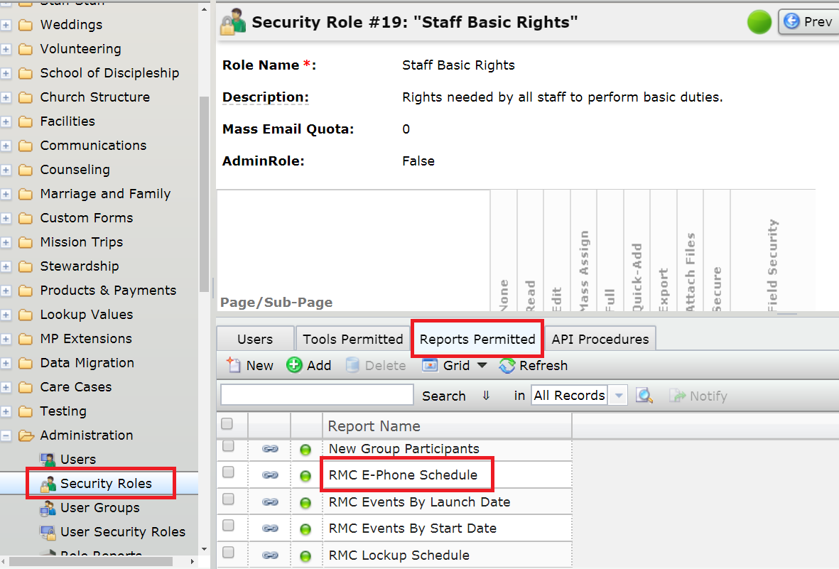
Place your screenshot here
Assign User Permissions
Notes:
Next, go to the Administration -> Security Roles page.

Slide 22
Demonstration
Let’s Do This!

Slide 23
Thanks!
Any questions?
You can find me at:
mattp@rmcalvary.org
Presentation Resources
https://rmcalvary.org/mpug2018

